Slide 1
Lecture 14 Multi-threading Courtesy of A. Shrivastava (ASU) & Tack-Don Han (Yonsei)
Computer Architecture-Module5
Department of Computer Science
Kyoungwoo Lee

Slide 2
Where are we and where to?
Assembly Language
Simple Processor Design
Pipelined Processor
Memory Hierarchy
Superscalar
Register Scoreboarding
Register Renaming
Interrupt and Exception Handling
Vector Processor
Multi-threading

Slide 3
Agenda
Multithreading
How to Multithread
Chip Multiprocessing

Slide 4
Multithreading
Multithreading

Slide 5
Multithreading – Why?
Difficult to continue to extract instruction-level parallelism (ILP) or data-level parallelism (DLP) from a single sequential thread of control
Many workloads can make use of Thread-Level Parallelism (TLP)
Multiple sequential jobs
Multithreaded applications
Multithreading uses TLP to improve utilization of a single processor

Slide 6
Multithreading
Consider the following sequence of instructions through a pipeline
T1: LW r1, 0(r2)
LW r5, 12(r1)
ADDI r5, r5, #12
SW 12(r1), r5
t0
t1
t2
t3
t4
t5
t6
t7
t8
t9
t10
t11
t12
t13
t14
F
D
X
M
W
F
H
H
D
X
M
W
F
H
H
D
X
M
W
F
H
H
D
X
M
W

Slide 7
Multithreading
How can we guarantee no dependencies between instructions in a pipeline?
One way is to interleave execution of instructions from different program threads on the same pipeline
– Micro context switching
Interleave 4 threads, T1-T4, on a non-bypassed 5-stage pipe
T1: LW r1, 0(r2)
T2: ADD r7, r1, r4
T3: XORI r5, r4, #12
T4: SW 0(r7), r5
T1: LW r5, 12(r1)
T1: LW r1,0(r2)
LW r5,12(r1)
ADDI r5, r5,#12
SW 12(r1),r5
T2: ADD r7,r1,r4
SUB r5,r7,r1
…
…
T3: XORI r5,r4,#12
ADD r5,r2,r8
…
…
T4: SW 0(r7),r5
MUL r2,r1,r3
…
…
t0
t1
t2
t3
t4
t5
t6
t7
t8
Last instruction in a thread always completes writeback before next instruction in the same thread reads regfile
F
D
X
M
W
F
D
X
M
W
F
D
X
M
W
F
D
X
M
W
F
D
X
M
W

Slide 8
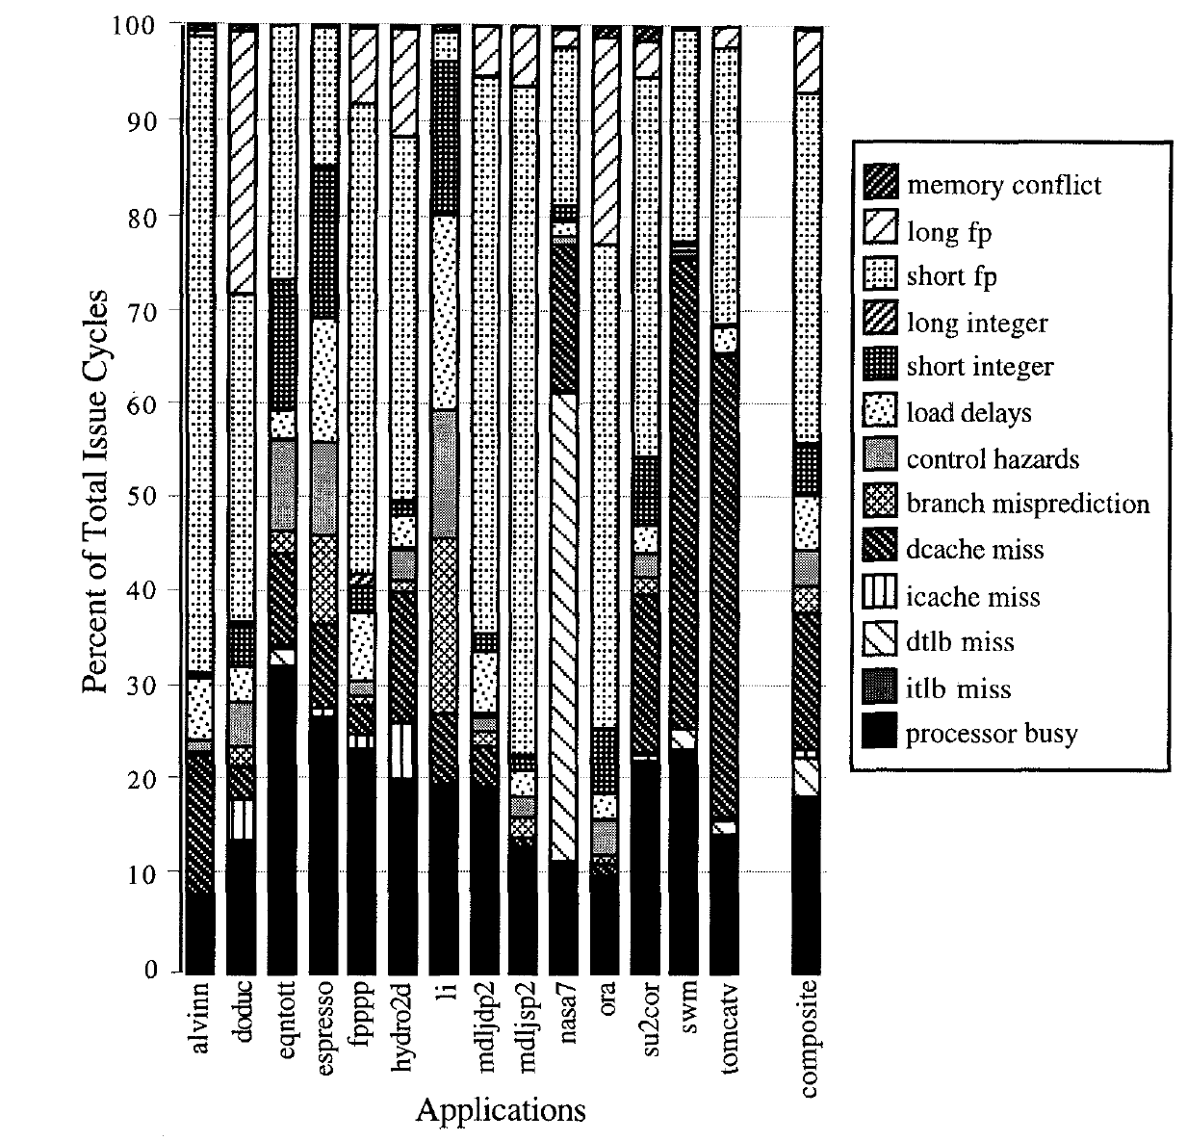
For most apps, most execution units lie idle in an OoO superscalar
For an 8-way superscalar.
From: Tullsen, Eggers, and Levy,
“Simultaneous Multithreading: Maximizing On-chip Parallelism”, ISCA 1995.

Slide 9
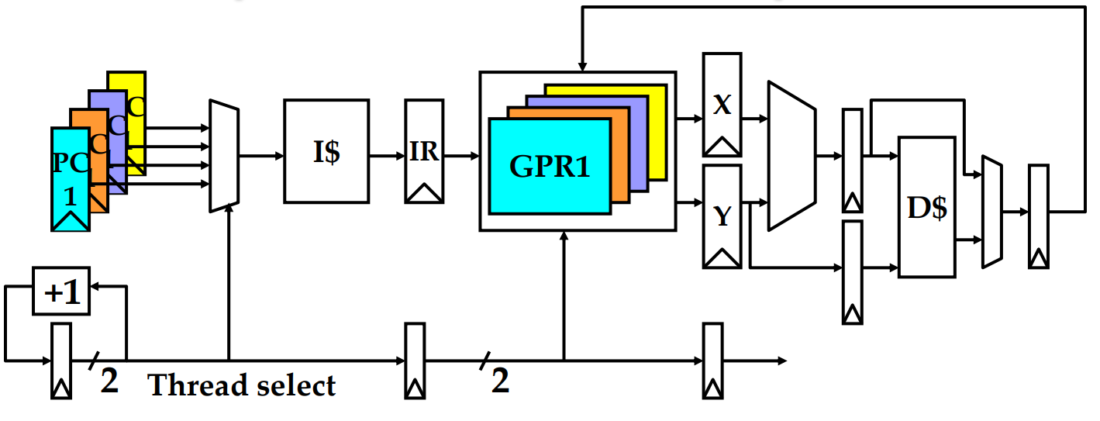
Simple Multithreaded Pipeline
Have to carry thread select down pipeline to ensure correct state bits read/written at each pipe stage

Slide 10
Multithreading Costs
Each thread requires its own user state
PC
GPRs
Also, needs its own system state
virtual memory page table base register
exception handling registers
Other overheads:
Additional cache/TLB conflicts from competing threads
add larger cache/TLB capacity
More OS overhead to schedule more threads
where do all these threads come from?

Slide 11
Granularity of Multithreading
Multithreading

Slide 12
How to multi-thread ?
Coarse-grained multithreading
CPU switches every few (100~1000) cycles to a different thread
When does this make sense?
Memory Access
Cost: Less hardware support
Coarse-grained multithreading
Fine-grained multithreading
CPU switches every cycle to a different thread
When does this make sense?
Data Hazards
Cache Misses
Cost: Does not fully utilize resources in multi-issue architecture
Coarse-grained multithreading
Simultaneous Multithreading
Instructions from multiple threads issued on same cycle
Uses register renaming and dynamic scheduling facility of multi-issue architecture
Pro: Maximizes resource utilization
Cost: More hardware support

Slide 13
Conceptual Diagram
Thread A
Thread B
Thread C
Thread D

Slide 14
Coarse Multithreading
Stalls for A and C would be longer than indicated in previous slide Assume long stalls at end of each thread indicated in previous slide
A
A
D
C
B
C
D

Slide 15
Fine Multithreading
Thread A
Thread B
Thread C
Thread D
Skip A
Long Stalls in A

Slide 16
Simultaneous Multithreading
Skip C
Long Stalls in A & C
Skip A

Slide 17
CMP: Chip Multiprocessing
Multithreading

Slide 18
Superscalar Machine Efficiency
Issue width
Instruction issue
Completely idle cycle (vertical waste)
Time
Partially filled cycle, i.e., IPC < 4
(horizontal waste)
Notes:
Focus is switching to function unit efficiency (as a measure of throughput).

Slide 19
Vertical Multithreading
Issue width
What is the effect of cycle-by-cycle interleaving?
removes vertical waste, but leaves some horizontal waste
Instruction issue
Second thread interleaved cycle-by-cycle
Time
Partially filled cycle, i.e., IPC < 4
(horizontal waste)

Slide 20
Chip Multiprocessing (CMP)
What is the effect of splitting into multiple processors?
reduces horizontal waste,
leaves some vertical waste, and
puts upper limit on peak throughput of each thread.
Issue width
Time

Slide 21
Ideal Superscalar Multithreading [Tullsen, Eggers, Levy, UW, 1995]
Interleave multiple threads to multiple issue slots with no restrictions
Issue width
Time

Slide 22
O-o-O Simultaneous Multithreading [Tullsen, Eggers, Emer, Levy, Stamm, Lo, DEC/UW, 1996]
Add multiple contexts and fetch engines and allow instructions
fetched from different threads to issue simultaneously
Utilize wide out-of-order superscalar processor issue queue
to find instructions to issue from multiple threads
OOO instruction window
already has most of the circuitry required to schedule from multiple threads
Any single thread can utilize whole machine

Slide 23
Summary: Multithreaded Categories
Fine- Grained
Coarse- Grained
Simultaneous
Multithreading
Time (processor cycle)
Superscalar
Multiprocessing
Thread 1
Thread 3
Thread 5
Thread 2
Thread 4
Idle slot

Slide 24
Assignments
Assume there are four threads T1, T2, T3 and T4 with 100 instructions each. The instructions in the each thread are dependent on the previous instruction, (for example in thread T1, I2 is dependent on I1, I3 on I2… so on) so that if I1 is issued in cycle x, I2 can be issued earliest at cycle x+2. The threads do not have any inter-thread dependency. Assume each instruction takes one cycle to complete. The thread switching overhead is 2 cycles.

Slide 25
Question 1
Consider a single cycle MIPS processor with 1 PC and 1 Register File. If there is no interleaving of threads, meaning one thread completes before the start of the next thread, what will the total execution time in cycles for completion of all the four threads?
100
400
403
600
803

Slide 26
Question 2
Consider a single cycle MIPS processor having 1 PC and 1 Register File, and a Coarse-grained Multithreading of 10 instructions (meaning 10 instructions from T1 execute first, followed by a switch to T2. 10 instruction of T2 executes followed by a switch to T3 and so on), what will be the execution time in cycles for completion of all the four threads? (Note: During switching of threads since there is no inter-thread dependency the first instruction of the next thread can be issued right away).
403
838
942
1200
1500

Slide 27
Question 3
For the same processor configuration as the above question, if there is a Fine-grained Multithreading of 1 instruction (meaning I1 of T1 executes followed by a context switch to execute I1 of T2… so on. If I1 of T1 is issued in cycle 1, the I1 of T2 is issued in cycle 4), what will be execution time in cycles for completion of all the four threads?
400
800
900
1198
1500

Slide 28
Question 4
Now consider a single cycle MIPS processor with 4 PCs and 4 Register Files, and a single issue Hardware Multithreading (meaning each thread has its own PC and Register File, so there is no context switching overhead but it can issue only one instruction per cycle. For example I1 of T1 is issued at cycle 1, I1 of T2 is issued in cycle 2 and so on). What will be execution time in cycle for completion of all four threads?
400
800
900
1200
1500

Slide 29
Question 5
Now consider a single cycle MIPS processor with 4 PCs and 4 Register Files, and a dual-issue Simultaneous Multithreading (meaning each thread has its own PC and Register File, so no context switching overhead but it can issue two instructions in parallel per cycle. For example I1 of T1 and I1 of T2 can be issued in cycle 1 followed by I1 of T3 and I1 of T4 in cycle 2). What will be execution time in cycle for completion of all four threads?
100
200
400
799
800

Slide 30
Summary
Multithreading
Coarse-grained Multithreading, Fine-grained Multithreading, Chip Multiprocessing, Simultaneous Multithreading
This is the end of Lectures!!

